Slide 1
Inclusive Design & Accessibility
Design Stream

Slide 2




Intro
Hey there! I’m Julianna. I work on helping the Canadian Digital Service create accessible and inclusive services for Canadians.
julianna.rowsell@cds-snc.ca
https://github.com/jrowsell
@juliannarowsell

Slide 3
Ice Breaker - Impacts of accessibility, inclusive and exclusion
Notes:
A More In-Depth Primer
When working with anyone new to thinking about inclusive design, I like to have them perform an in-depth thought experiment.
It goes something like this:
There’s a moderately heavy door ahead that swings out towards you. There is a bright light just above the door, shining down. Vertical bar handles are on either face and it is locked by a keypad on the left.
How do you get through the door?
Now imagine you are holding bags of groceries in each arm. How do you open the door?Imagine you are on crutches. How, now?What if you are in a wheelchair?What if you just went to the eye doctor and your pupils are dilated?
What if you can’t see at all?
This thought experiment sheds light on how we can better make things for all people. Instead of thinking about simply designing a door, we can start to look at the door (or any other product) from multiple vantage points and different types of interactions.

Slide 4
Activity 1: Think about a time when you or someone you know was directly impacted by accessibility, inclusion or exclusion.
Notes:
Briefly write that down on a post-it note. Associate the situation and feelings that this experience created.
Time: 20 minutes

Slide 5
What is Inclusive Design?
Notes:
Time 40 minutes

Slide 6
What is an inclusive design?
location
gender
language
education
culture
Inclusive Design
Accessibility
vision
hearing
cognitive
mobility
Notes:
Considers the full range of human diversity with respect to ability, language, culture, gender, age, and other forms of human difference. The same thinking can, and should be applied to neurological, cultural, ideological, or environmental viewpoints. Those, too, can play a huge factor into how people use and interpret products and their design.
Of course, thought experiments are only a good first step. They pale in comparison to all the great amount of data and insights obtained by user testing and interviews. The absolute best way to design for multiple situations is to work with the people who live through them. Again, interviews and testing reveal loads of information that mere thinking cannot.
Inclusive Design isn’t solely about making sure a small percentage of the population can use your product. It’s about making sure anyone, in any situation, can use your product. And that benefits everyone.

Slide 7
Diversity
As Jutta Treviranus from the Inclusive Design Research Centre says, “Diversity is our world’s greatest asset and inclusion is our biggest challenge”.
Notes:
In broad terms, diversity is any dimension that can be used to differentiate groups and people from one another. It means respect for and appreciation of differences in ethnicity, gender, age, national origin, disability, sexual orientation, education, and religion.

Slide 8
Inclusion
Inclusion is a state of being valued, respected and supported. It’s about focusing on the needs of every individual and ensuring the right conditions are in place for each person to achieve their full potential.

Slide 9
Why designing for accessibility benefits everyone
Designing for inclusivity opens up our services and experiences to more people with a wider range of abilities. All humans are growing, changing, and adapting to the world around them every day. We want our designs to reflect that diversity.
Notes:
Every decision we make can raise or lower barriers to participation in society. It’s our collective responsibility to lower these barriers though inclusive products, services, environments, and experiences. Think about a time when you really needed to send a text message but your hands were busy. Maybe you were washing the dishes, which meant your hands were soapy and wet, making it difficult to use the touchscreen. Instances like these are common but they aren’t constant. You’re not perpetually washing dishes.
Now, ask yourself, “What if my hands were always busy? What if I couldn’t use my hands at all?”
Empathy should be at the heart of all User Experience design. The first step to building it is to think about the times when you’re not able to do the tasks you typically can. Those times can be frustrating, but they’re informative, as well. Inclusive Design aims to solve those frustrations, for all people, by looking at each problem from different perspectives.
By creating features that account for those times when you can’t use your product the way you typically do, you end up creating for people who may not be able to use it at all. This allows more people to use your product, more often. In the case of websites, the outcome could mean more traffic, which in turn potentially means more revenue.
Also consider that word of mouth is the most influential marketing strategy, thus it can also be the most damaging. If you don’t create accessible features for your site or product, potential users may not spread the word about it. You may end up isolating people who may otherwise become your best advocates. Worse, they may actively avoid it and suggest others do the same.

Slide 10
Don’t make assumptions
When aiming to design inclusively, it’s important to remember that not everyone can use your products the same way, or the way you may have designed them. Don’t make assumptions about how people use services. Every individual uses varying approaches to best meet their own needs. There are no average or “normal” users.
Notes:
For example, when building websites, consider how not everyone can control their computers the way you do. They may not be able to see the screen at all or may not have the mobility to push a mouse.
Inclusive Design is more than meeting accessibility compliance. It is much more than simply checking a few boxes to make sure colour and contrast ratios meet standards. Inclusive Design starts at the very beginning of any project, before pixels get pushed, before pens even hit sketchbooks.
Let’s take the previous thought experiment a step further. At the beginning of your next project consider asking, “How would this product work if I couldn’t see it? What if I couldn’t touch it, or move it? What if I couldn’t hear it, taste it, smell it?” This will help you think about people's pain points and usages differently, lending some guiding principles toward the design of your product.

Slide 11
What is Design Research?
Notes:
Talk to users Talk to users Listen to their concerns Respect their capacities
Inclusive design extends the benefits of good accessibility to a wider audience. Bad inclusive design compromises good accessibility.
Don’t make something cool if it reduces access to users with essential needs. If you do want a good inclusive design story then there are lots of them in Audio design.
Wayfindr and SeeingAI are both products developed with people with visual impairments that have great futures due to their inclusive design for everyone.

Slide 12
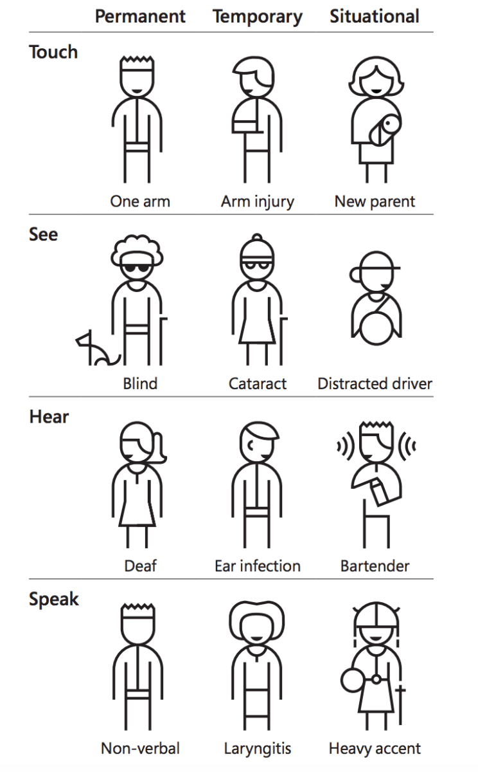
Inclusive Design
Recognise exclusion
“Disability is not just a health problem. It is a complex phenomenon, reflecting the interaction between features of a person’s body and features of the society in which he or she lives.”
–World Health Organization
Notes:
Learn from diversity
People adapt to diversity in unexpected ways. Putting people in the centre of the design process from the start lets us to gather valuable insights which would not have been considered else.
Solve for one, extend to many
A solution that works well for someone might also benefit other persons. Inclusive design works across a spectrum of related abilities, connecting different people in similar circumstances. For instance a solution designed for people with one arm might help people with an arm injury or a new parent who has situational disability to use both the hands.

Slide 13
Recognize Bias
There are varying degrees to which a user might be limited with respect to using your product, ranging from very temporary to permanent.
Notes:
A user might be washing dishes, holding their newborn child, have a broken wrist, or be an amputee. Get to know the people who might be using your product. Try to understand them and their pain points, their needs, their motivations. Look at your product through their eyes as much as you possibly can. Even more importantly: interview them and have them test your product – repeatedly, if possible.
Naturally, we tend to design for how we individually might be able to use a product. We consider interaction models – swipe, tap, pinch, click, slide, etc – that we, ourselves, are able to perform. That’s designing to our own capabilities. Sometimes, designers can step outside of themselves and consider how to use their product as someone who has a different set of capabilities. This is problematic, though. We easily fall into the trap of thinking people are only capable in one interaction or another. This limits our ideation around interaction methods, and stops us from thinking across different perspectives.
Some abilities and limitations are permanent, some are not. Capabilities change, and change often, depending on the situation. When we design for situations, we start to approach them from multiple angles. We can brainstorm new, different ideas as to how to solve a problem outside of a limited set of capabilities.

Slide 14

Pillars of Inclusive Design
No user is average
Every user deserves equal access
Provide understand content for every user
Every user deserves our trust and respect
Notes:
Inclusive Design
Recognize diversity and uniqueness (people and places)
Personalize (wherever possible, let people be themselves - empower users )
Ask yourself: was that design choice really brilliant or did I just exclude someone? (beware of introducing assumptions)
How do I bridge the gap I just created? (Identify the gap, between the core and the outliers - you’ll see quite tangibly where innovation can happen.)
The magic is at the margins * Innovation is often driven from meeting needs (speech recognition, speech to text, voice assistants) * Benefits the majority
Supports the spectrum
Resilency
EDGE | Outliers
How many of you consider yourself average? So why do we design for the average?
Use inclusive process and tools - get experts to make the best solutions - talk to people to find out what works for them, and what conditions that they might be using them in?
Have a broader benefitical impact - solve for everyone, the goal is to be better than yesterday.

Slide 15
Inclusive design processes
Are iterative
Specify the context of use (who , what where)
Discover, understand and translate the wants and needs of the user
Involves stakeholders and end users
Adapt and apply guidelines and standards
Evaluate designs again requirements and test with users

Slide 16
What’s the Difference Between Inclusive Design and Accessibility?
Notes:
While inclusive design considers from the very beginning how something might be easily useful and enjoyable for as many individuals as possible, accessibility traditionally means making special considerations for people with disabilities. It’s the difference between designing a watch that can be read by touch or sight, and taking a standard analog watch and adding braille instead of numbers. The first example considers the functionality and beauty of a watch that doesn’t require sight, while the second example tries to take something designed for vision and make it work for touch without addressing some of the problems this modification creates.
Unlike assistive devices, inclusive design doesn’t specifically target people with disabilities. While assistive devices fill in the gaps left by exclusionary design practices, inclusive design aims to evolve products beyond their conventional definitions, changing our standards for products. Assistive devices aim to remove a barrier for people with disabilities. Inclusive design strives to fundamentally redesign a product so that the barrier does not exist in the first place. Assistive technology is reactive. Inclusive design is proactive.

Slide 17
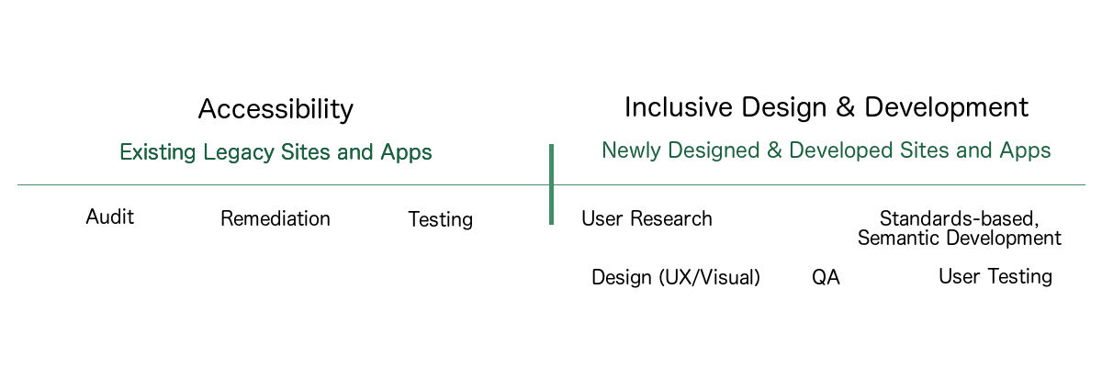
Notes:
Accessibility is the awareness of, attention to, and remediation of existing factors that prevent individuals with varying abilities from performing tasks or obtaining information. It’s global in nature.
In my experience, sadly, it is rare for accessibility to get appropriate and timely attention and consideration at the beginning of a project. In many cases, accessibility is a last minute “fix” or a “fast follower” task after a launch.
With real-world accessibility activities, sites or apps are reviewed and analyzed for their compliance to standard guidelines for accessibility, such as the Web Content Accessibility Guidelines (WCAG).
Violations are reported and recommended remediations (fixes) are designed, developed and implemented, typically with the least amount of visual change as possible.
These items must go through a quality assurance phase, and often, are sent back for re-development work. In some cases (yet not enough), proper usability testing is performed, typically when mandated or due to legal action.
These activities tend to make what is lacking accessibility, more accessible, while really not changing much in the design, except for accessibility issues such as color contrast.
Efforts are expensive, as it takes more time and resources to remediate sites and apps than it would if they had been created in an accessible manner at the beginning.
Additionally, much of remediation work only includes compliance fixes. It doesn’t alter the user experience, as this would be potentially intrusive to the design.
You’ll find many compliant websites which offer poor experiences for people with disabilities.
If accessibility is considered upfront, by design, and developed in accessible ways, accessibility can be a seamless facet to the entire workflow process. This, in my mind, is considered inclusive design and development.

Slide 18
Designing inclusive personas
Notes:
Imagine performing user research and developing personas that include individuals with low-to-no vision, or individuals who are deaf or hard-of-hearing.
Also consider individuals using non-mainstream input devices and assistive technology, such as switches, or puff and sip.
Moreover, considerations are needed for cognitive and learning impairments that are invisible to the eye.
Your group of designers will now need to recognize more than color contrast when creating designs.
Font and UI element size and spacing, proper organizational and semantic headings and sub-headings, impact of accordions, tooltips, sliders, toggle buttons and carousels, all of these factors are more readily addressed during the design phase rather than while remediating, when design changes may be required.
With the knowledge of accessibility considerations upfront, accessibility will find itself seamlessly in the resulting designs.
Developers, who for years have been accustomed to leveraging non-semantic elements like divs and spans to perform their scripted magic, now need to think holistically about code semantics and craftsmanship as they approach development.
They’ll also need to pay attention to the relationships between labels, input fields, and their messaging, as well as the roles, properties, and states of custom widgets.
Inclusive Design addresses the second portion of that famous quote, “Teach a designer or developer to design and develop in an accessible manner, and they will consider it in all their work.”
Rather than focusing on providing remediation steps, teach accessible considerations when designing or coding upfront.
You’ll reduce the time and resources needed to repeatedly remediate websites and apps.
And that is better for all.

Slide 19
The Problem With Good Design: Why Good Design Isn’t Good Enough
Notes:
The truth is that “good design” considers the best form and function for some people, but excludes many people on the basis of ability — and individuals with disabilities are often left out. We want to change that.
Design should be inclusive, bringing more people in instead of shutting them out. We believe that design shouldn’t discriminate or divide us up, but bring us together.
Individuals with disabilities should have equal and integrated access to quality products, services, and structures — that everyone has a right to enjoy beautiful, functional design, and that we all benefit when we enjoy design together.

Slide 20
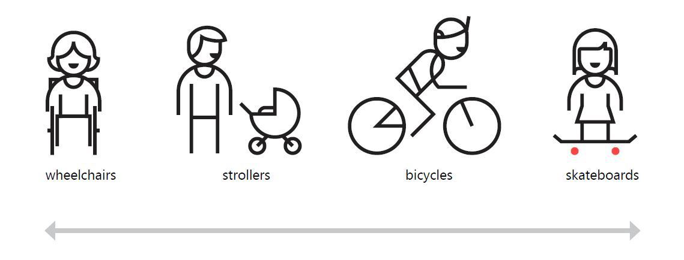
We all can be considered disabled in some scenarios
Notes:
We all can be considered disabled in some scenarios. When driving a car, touch interaction is impaired. Everyone can benefit from inclusive voice-control (assistants like Cortana or Siri for example). Having a newborn on your hands? You’re limited to one hand for interaction with a smartphone. You are disabled. Temporarily. My favorite example are curb cuts for easier and safer crossing the street on a wheelchair. It is mainly for people with permanent disabilities and can seem like a significant design constraint, but… it actually also helps people with strollers, kids on a bicycles or can save you from injury. Inclusive design is simply better design.

Slide 21

Design Research & Testing Cover accessibility and inclusive design issues when conducting user research. Consider potential visual, hearing, motor, and cognitive disabilities. Incorporate accessibility considerations in your personas, or user stories. When possible, include users with different abilities in user research.
Notes:
References: Personas for accessible UX

Slide 22
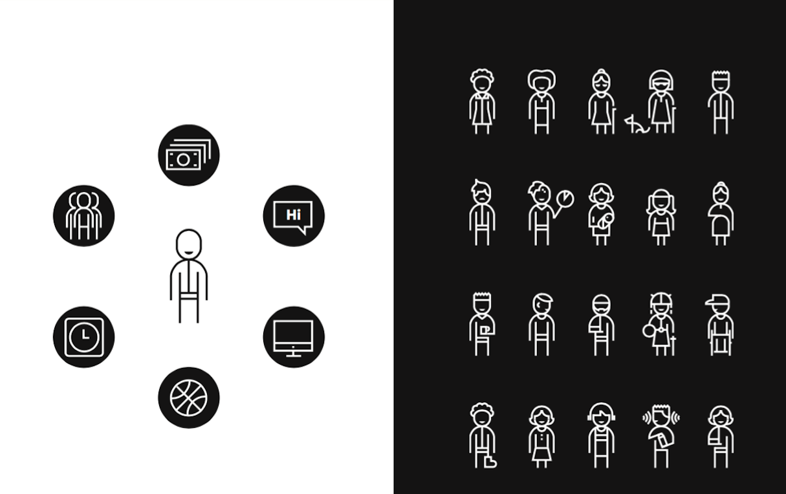
We can’t assume all senses and abilities are fully enabled all the time
Notes:
Microsoft’s Inclusive Design Tookit argues that there’s no such thing as ‘normal’ and that we can’t assume all senses and abilities are fully enabled all the time.

Slide 23
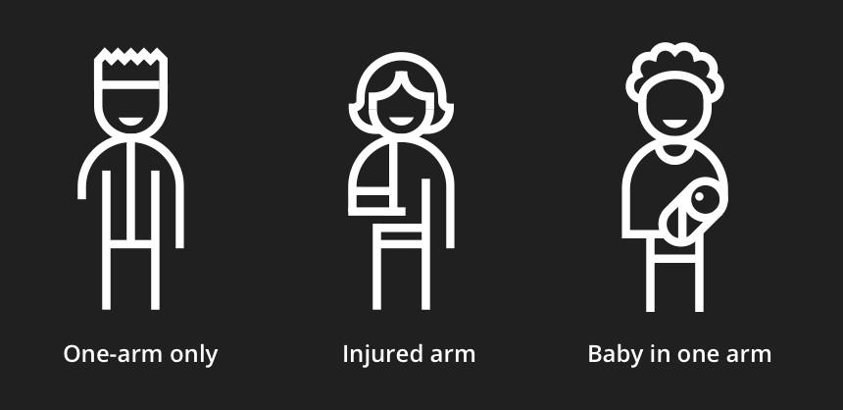
Example of permanent, temporary and situational disability

Slide 24
Design with Empathy
Empathy can help us gain a deeper appreciation and understanding of people’s emotional and physical needs. This includes that way they see, understand and interact with the world around them.

Slide 25
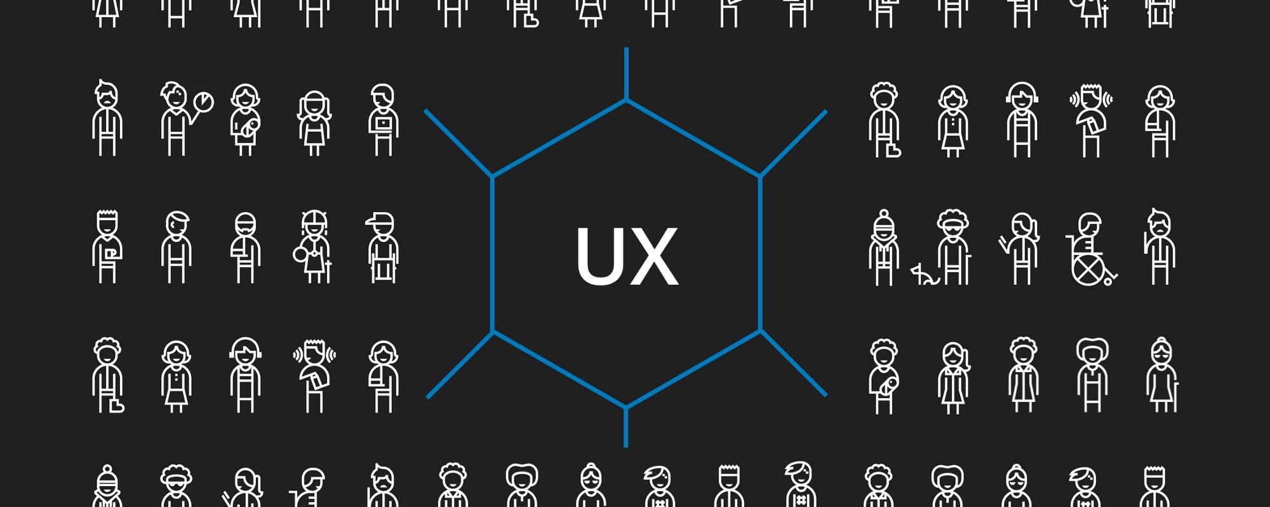
Notes:
As a UX designAccessibility allows users of all abilities to understand, use and enjoy the web. As designers, it is our responsibility to make sure we design in a way that is usable to all users irrespective of their situation, abilities or context.
The first and foremost step to build an accessible product is to build empathy and install an inclusive design mentality.
Accessibility is not confined to a group of users with some different abilities, for example, visual, motor, auditory, speech, or cognitive disabilities, rather it extends to anyone who is experiencing any permanent, temporary or situational disability, e.g., having only one arm is a permanent condition, having an injured arm is a temporary, and holding a baby in one arm is situational — in each case the user is able to complete tasks with only one hand.
Therefore, the aim is to make web content more usable to users in general, it is important to build empathy and celebrate accessibility requirements as a set of design constraints to build a better product. Accessibility is a vast subject. This article focuses mainly on guidelines specific to designers and content writers (to some extent) that would help to build a more accessible product.

Slide 26
Video - Sinead Burke - Why design should include everyone
Notes:
Time: 15 Minutes

Slide 27
These design assumptions are narrow
inclusive design will hurt UX for majority of users
disability is a (permanent) personal health condition
most of us don’t need inclusive design
This process
designing inclusively lets us reach a much broader audience
disability can happen at any time, and does not have to be permnant
most of us benefit from inclusive design
Notes:
If we start our design process narrow-minded, concentrating on familiar demographics, regions, personal abilities or languages, we will end up with a product of limited application. It will be bad for users, but also bad for us — product makers. Designing inclusively lets us to reach much broader audience with things we create. Inclusive design helps improve customer satisfaction. It’s pure profit — for both sides.
Second, I had to change my understanding of what disability is. Old definition concentrates on biological or mental part of this problem, describing it as a health condition. Inclusive design approach brings us much broader meaning of disability. “Disability is designed”. It’s not a personal attribute or health condition, it’s a mismatch in human interaction with other humans or environment. If we think about it that way, disability is not a state nor property. It’s more like situation.

Slide 28
We need designers who have experienced barriers. What we want to produce is not a uniform set of individuals with specific competencies, but a group of individuals that can work as a team, that each can contribute a diverse perspective.
Inclusive design doesn’t mean you’re designing one thing for all people. You’re designing a diversity of ways to participate so that everyone has a sense of belonging. - Susan Goltsman

Slide 29
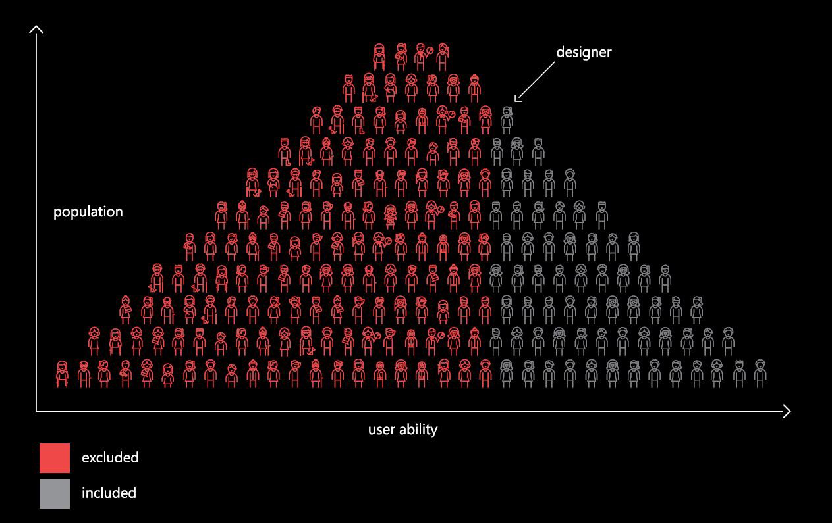
Notes:
Microsoft Inclusive Design Toolkit

Slide 30
No two people with the same disability are alike
Deafened since birth
Partial hearing loss
Hearloss later in life
Listening in a crowded room
Blind since birth
Blind later in life
Vision loss
Eye fatigue from over stimulation

Slide 31
Inclusive design has a strong heritage in accessibility. We define inclusive design as a set of practices that can be applied to any existing design process. Inclusive is how we design. It’s our tools and methods. In comparison, accessibility offer ways to improve access to what is already designed.
A curb cut is still a curb. The cut makes the curb more accessible. Inclusive design gives us ways to design for ever-changing human motivations and needs. And design systems that can adapt to fit those diverse needs.

Slide 32
Video - Elise Roy - When we design for Disability, everyone benefits (Design thinking)
Notes:
Time: 15 Minutes

Slide 33
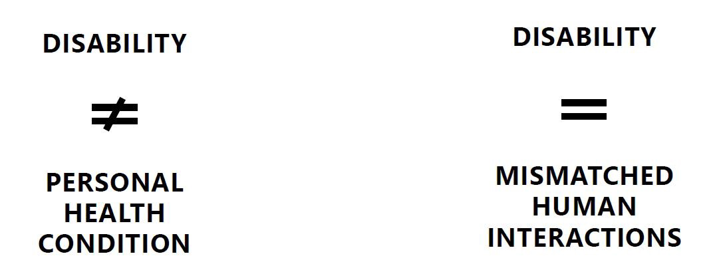
How can we resolve a mismatch?
Notes:
We all can be considered disabled in some scenarios. When driving a car, touch interaction is impaired. Everyone can benefit from inclusive voice-control (assistants like Cortana or Siri for example). Having a newborn on your hands? You’re limited to one hand for interaction with a smartphone. You are disabled. Temporarily. My favorite example are curb cuts for easier and safer crossing the street on a wheelchair. It is mainly for people with permanent disabilities and can seem like a significant design constraint, but… it actually also helps people with strollers, kids on a bicycles or can save you from injury. Inclusive design is simply better design.

Slide 34
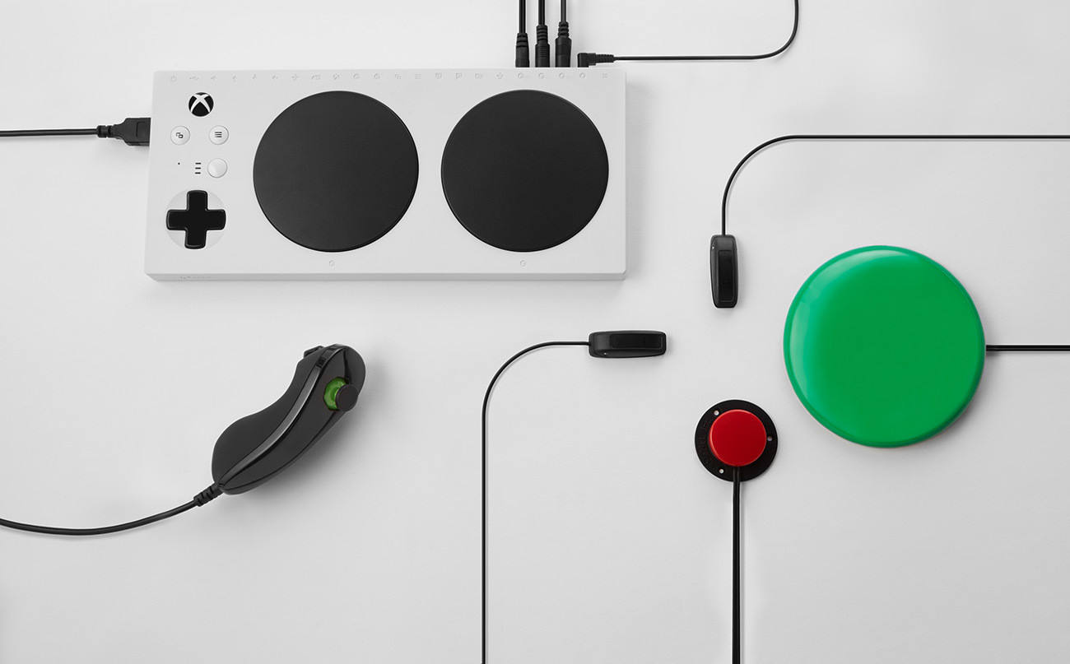
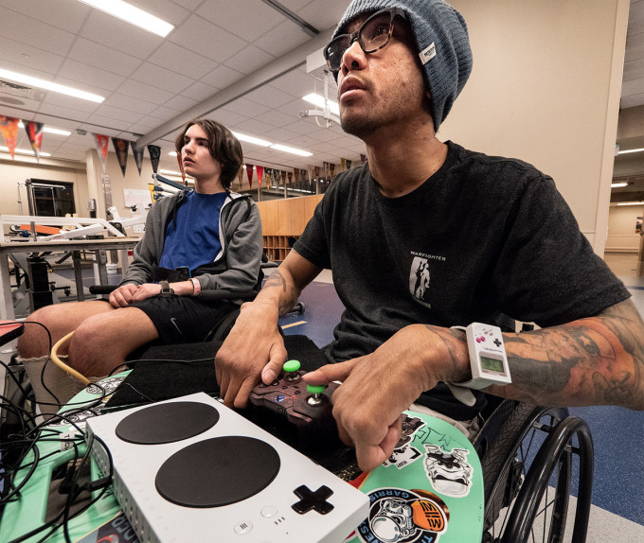
Examples of good inclusive design
Notes:
Microsoft’s Xbox Adaptive Controller is an inspiring example of inclusive design
Every gamer with a disability faces a unique challenge for many reasons, one of which is the relative dearth of accessibility-focused peripherals for consoles. Microsoft is taking a big step toward fixing this with its Xbox Adaptive Controller, a device created to address the needs of gamers for whom ordinary gamepads aren’t an option.

Slide 35

An example of ‘bad’ inclusive design
Notes:
Combined ramp and stairs. Ramp zig zags across stairs.
I am reminded of discussions, maybe 2-3 years ago, about that combined staircase and ramp in the photo above. I think it is in Vancouver but I may be wrong (addition: thanks to Dean Birkett in the comments, it’s in Robson Square in Vancouver).
Again, it looks great.
Again, it got lots of coverage as cool design
Again, it was silly.
The practical problems were that:
for wheelchair users: it was too steep
for people with walking impairments: there were not enough handrails
for everyone: there were trip hazards
Looking cool and being usable is entirely possible but we need to point out when it doesn’t work.

Slide 36
Practical Considerations
Recognize bias
Do design research
Follow ethical practices
Actively listen
Test with users
Consider diverse needs
Build inclusive personas
Conduct cognitive walkthroughs
Offer different ways to engage
Best practices for building inclusive services and experiences that consider diverse needs.

Slide 37
Considerations
Oriented
Scope
Iterate
Ideate
Optimize
to get inclusive design ‘right’
Notes:
Before deciding on colours, fonts, etc., it is important to get the wireframes of the new website ready. The main issues to consider from an accessibility point of view is that the content must have a meaningful reading order with consistent navigation and layout throughout the website. These two components will benefit all the website visitors not just people with disabilities.
Other factors to consider in the design process is using scalable fonts and having sufficient colour contrast. It is important to remember that the visual appearance of a site is controlled by style sheets; accessibility should not have any impact on visual design.
At the end of the process you will end up with an accessible and usable website by a large diverse set of users. It is important to design for people who are young, old, frequent users, casual users, and those who just enjoy a quality experience.

Slide 38
Activity 2: Inclusive Design Toolkit
Notes:
Time: 20 Minutes

Slide 39
What is Accessibility
Notes:
Time: 40 Minutes

Slide 40
Accessibility
Accessibility is about ensuring that the things we design, whether they are products, services, devices or environments are accessible by people regardless of disability.
Notes:
Accessibility

Slide 41
"Accessibility is an attribute, while inclusive design is a method. And while practising inclusive design should make your products more accessible, it's not a process for meeting all accessibility standards. Ideally, accessibility and inclusive design work together to make experiences that are not only compliant with standards but truly usable and open to all.” - Microsoft Inclusive Design Toolkit

Slide 42
Accessibility is Everyone’s Responsibility

Slide 43

What can we do to ensure we are creating inclusive and accessible services?
Notes:
Incorporates User Research on product teams
Held an accessibility workshop for the entire team
Demoed keyboard and screen reader navigation to a product team
Hosted a Service Design Barriers panel with persons with disabilities from vision, hearing, cognitive and mobility related disabilities
Conducted usability testing from diverse groups include testing with person with disabilities
Written blog’s about accessibility
Much more to come in 2019 - Inclusive Design workshops, partnering with the Canadian School of Public Service, Accessibility clinics for developers

Slide 44
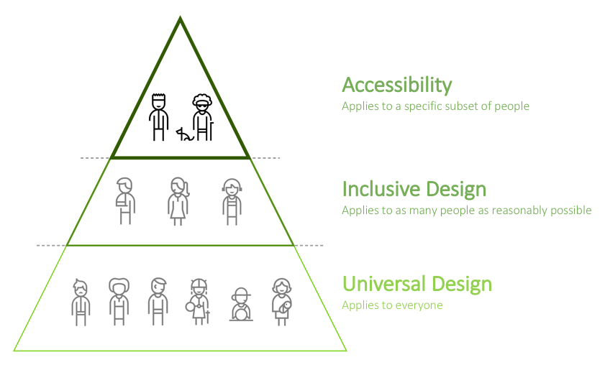
How inclusive design and accessibility fit together

Slide 45
These principles are building blocks that link accessibility, inclusion and diversity.

Slide 46
Are the Government of Canada’s products and services required to be accessible?
Notes:
Yes. A backgrounder on accessibility in the Government of Canada, the court decision regarding the appeal in the Donna Jodhan case circa 2012. It covers the background, facts & requirements. If you are new to accessibility in the Government of Canada or are indirectly involved in accessibility this is a good place to start. https://bit.ly/2S94ALq "The act will benefit all Canadians, especially Canadians with disabilities, by proactively identifying, removing and preventing barriers in a number of priority areas, while also setting accessibility standards and regulations." - Minister Carla Qualtrough Bill C-81 the Accessible Canada Act went through it's second reading in the senate today. This bill would establish the Canadian Accessibility Standards Development Organization and the position of Chief Accessibility Officer, who would advise the minister on emerging and systemic accessibility issues in Canada.

Slide 47
The Web Content Accessibility Guidelines or WCAG is a set of guidelines for making content accessible for all people, including those with disabilities. The Government Of Canada has been required to meet WCAG 2.0 AA since 2012 after a court decision in the Donna Jodhan vs. Attorney General.
Notes:
WCAG was developed by the World Wide Web Consortium (W3C). Although their focus is not solely on accessibility, the W3C is widely regarded as the highest authority in web accessibility goals and universal design.
The consortium provides an online web development resource center that includes sample code implementations to demonstrate and encourage the use of standards, as well as prototypes and sample applications to illustrate new technology.
What is WCAG?
WCAG, which stands for Web Content Accessibility Guidelines, is a set of guidelines making digital content accessible for all users, specifically, users with disabilities.
W3C has released three WCAG versions: WCAG 1.0, 2.0, and 2.1.

Slide 48
Web Content Accessibility Guidelines
Outlines best practices for making web content universally perceivable, operable, understandable, and robust.
Defines criteria for successful inclusive web design, with ascending levels of compliance (levels A, AA, and AAA).
Is composed and reviewed by a global community of digital experts.
Connects the world through common information technology and user experience standards.
Notes:
WCAG 2.0’s essential design concepts are labeled perceivable, operable, understandable and robust.
Designers and developers are asked to meet all four of these principals for disabled users, and then select a degree of compliance (Level A, AA, or AAA).
The four design principals are defined as follows:
Perceivable: Information and user interface components must be presentable to users in ways they can perceive. This means that users must be able to perceive the all relevant information in your content.
Operable: User interface components and navigation must be operable. This means that users must be able to operate the interface successfully.
Understandable: Information and the operation of user interface must be understandable. This means that users must be able to understand the information as well as the operation of the user interface.
Robust: Content must be robust enough that it can be interpreted reliably by a wide variety of user agents, including assistive technologies. Content must be accessible to all users, keeping up with advances in technology, such as mobile technology.

Slide 49
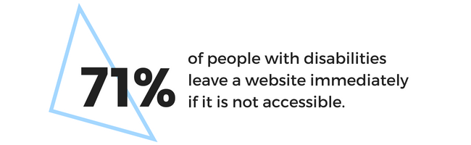


Slide 50
Misconceptions - Designing for Accessibility
Notes:
Good inclusive design is complex. It is not a barrier to innovation in design, and the end-result does not have to be lifeless or bland.
Accessibility does not mean removing all colour and graphics. What it does mean is that you must think about how colour is used, and provide alternative content for images and other graphical objects that are informational or functional. Although you must adhere to some constraints when designing with accessibility in mind, working within these guidelines will create a good-looking website that is usable by all your visitors.

Slide 51

Introspective
Guiding principles for creating accessible and inclusive services. These are a consistent set of guidelines for making content accessible for people with disabilities. They include: perceivable, operable, understandable, and robust (POUR).
These principles aim to create well-structured, simple, and intuitive experiences.

Slide 52
An image is worth 1,000 words. And it can cover the whole slide

Slide 53
Put people first; follow inclusive design principles to provide equal access by providing an comparable experience or humans with diverse abilities

Slide 55
Include accessibility from the start of service design

Slide 56
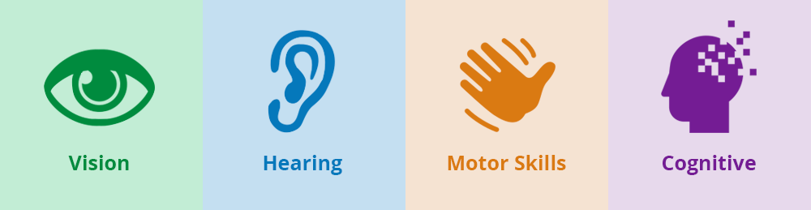

Slide 57
Strive to have a clear purpose and well-defined goals

Slide 58
Ensure that content is clear, use plain language

Slide 59
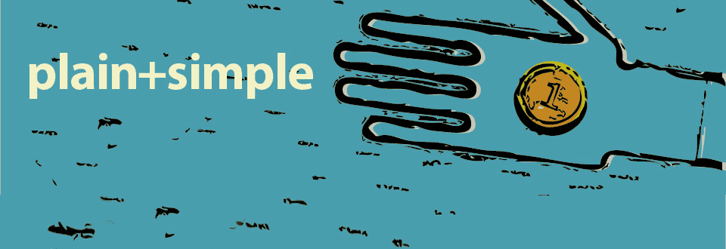

Slide 60
Provide helpful wayfinding — help people navigate to relevant content

Slide 61
Accommodate a range of people’s needs by providing choice and flexibility

Slide 62
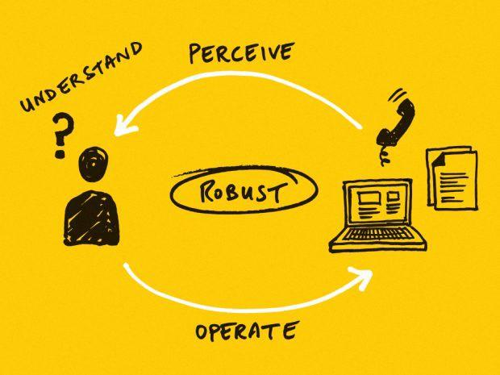

Slide 63
Include people with disabilities in user research, design, and testing of services

Slide 64
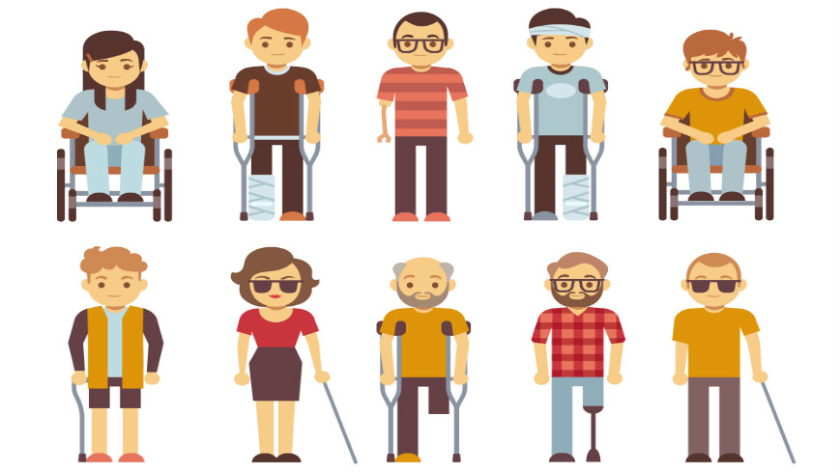

Slide 65
Use solid structure by building to standards: strive to meet WCAG 2.1

Slide 66
Test the online parts of a service for compatibility with assistive technologies

Slide 67
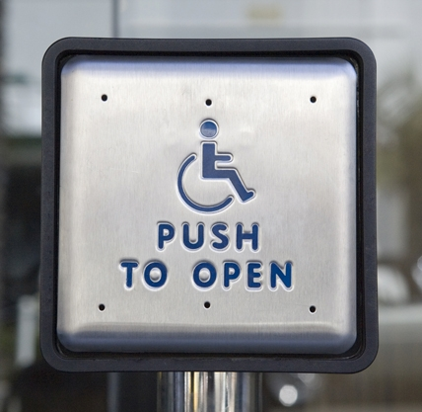

Slide 68
Have champions for accessibility on product teams and internal support teams

Slide 69
Resources should be compatible with current and future tools, include redundant modalities by offering choice

Slide 70
Practical Considerations
Text Alternatives
Adaptability
Distinguishable
Keyboard Accessibility
Time
Seizure safety
Navigability
Readability
Input assistance
Compatibility
Best practices for making web content universally perceivable, operable, understandable, and robust.

Slide 71
Together we can build more inclusive and accessible services.

Slide 72
Questions?

Slide 73
Roadmap for Accessibility

Slide 74
Roadmap for Accessibility
Be pragmatic: move forward with accessibility
Build capacity in inclusion
Prioritize change
Include persons with disabilities
Assign budget
Tap into expertise across sectors
Accessible services are less expensive
Plan for continued improvement
It seems immense: just start
Goal: Aim to be better than yesterday

Slide 75




digital.canada.ca
@CDS_GC
github.com/cds-snc

